Slide 1

History and Types of Programming Language
Sabrina Tarin Chowdhury

Slide 2
Objectives
History of Programming Languages
Why study programming languages?
Classifications of Programming Languages
Compilation vs. Interpretation
Implementation strategies
Programming Environment Tools
An Overview of Compilation

Slide 3
History of Programming Languages
At the beginning - only machine language
Machine Language : a sequence of bits that directly controls a processor, causing it to add, compare, move data from one place to another, etc.
Example: GCD program in x86 in machine language
3

Slide 4
History of Programming Languages
Assembly languages were invented to allow machine- level/processor operations to be expressed with mnemonic abbreviations
For example, to add two numbers, you might write an instruction in assembly code like this:
ADD F3 R1, R2, R3
A program called assembler is used to convert assembly language programs into machine code
Assembly Source File
Machine Code File
…
ADDF3 R1, R2, R3
…
Assembler
…
1101101010011010
…
4

Slide 5
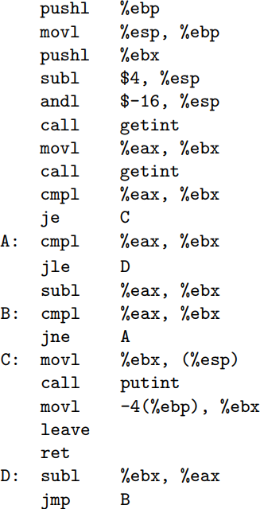
GCD program in x86 assembly:
pushing whatever is in register ebp onto the stack.
moves the current stack position into EBP which is the base of the stack
Subtract value in esp from hexadecimal 4
Bitwise and between hex -16 and value in esp
Input from user
5

Slide 6
History of Programming Languages
Assemblers were eventually augmented with elaborate “macro expansion” facilities to permit programmers to define parameterized abbreviations for common sequences of instructions
Problem: each different kind of computer had to be programmed in its own assembly language
People began to wish for machine-independent languages
These wishes led in the mid-1950s to the development of standard higher-level languages compiled for different architectures by compilers
6

Slide 7

History of Programming Languages
Thousands of high-level programming languages, and new ones continue to emerge
Why are there so many?
Evolution
Different Purposes
Personal Preference
7

Slide 8
Why study programming languages?
 Why do we have programming languages?
What is a language for?
Way of thinking -- way of expressing algorithms
Way of specifying what you want (see declarative languages; e.g., constraint solving languages, where one declares constraints while the system find models that satisfy all constraints)
Access special features of the hardware
8

Slide 9

Why study programming languages?
What makes a language successful?
easy to learn (BASIC, Pascal, LOGO, Scratch, python)
easy to express things, i.e., easy to use once fluent (C, Java, Common Lisp, Perl, APL, Algol-68)
easy to deploy (Javascript, BASIC, Forth)
possible to compile to very good (fast/small) code (C, Fortran)
backing of a powerful sponsor that makes them "free" (Java, Visual Basic, COBOL, PL/1, Ada)
real wide dissemination at minimal cost (python, Pascal, Turing, Erlang)
9

Slide 10

Why study programming languages?
Help you choose a language for specific tasks:
C vs. C++ for systems programming (e.g., OS kernels, drivers, file systems)
Matlab vs. Python vs. R for numerical computations
C vs. python vs. Android vs. Swift vs. ObjectiveC for
embedded systems
Python vs. perl vs. Ruby vs. Common Lisp vs. Scheme vs. ML for
symbolic data manipulation
Java RPC vs. C/CORBA vs. REST for networked programs
Python vs. perl vs. Java for scripting and string manipulations
10

Slide 11
Why study programming languages?
Make it easier to learn new languages
programming languages are similar (same way of doing things)
because it is easy to walk down family tree
 Important: concepts have even more similarity: if you think in terms of iteration, recursion, abstraction (method and class), then you will find it easier to assimilate the syntax and semantic details of a new language than if you try to pick it up in a vacuum
Think of an analogy to human languages: good grasp of grammar makes it easier to pick up new languages (at least Indo-European)
11

Slide 12
Why study programming languages?
Help you make better use of whatever language you use
understand implementation costs: choose between alternative ways of doing things, based on knowledge of what will be done underneath:
use x*x instead of x**2
avoid call by value with large data items in Pascal
avoid the use of call by name in Algol 60
choose between computation and table lookup
understanding "obscure" features:
In C, it will help you understand pointers (including arrays and strings), unions, catch and throw
In Common Lisp, it will help you understand first-class functions, closures, streams

Slide 13
Why study programming languages?
figure out how to do things in languages that don't support them explicitly:
lack of recursion in Fortran, CSP
unfold the recursive algorithm to mechanically eliminate recursion and write a non-recursive algorithm (even for things that aren't quite tail recursive)
lack of suitable structures in Fortran
use comments and programmer discipline
o lack of named constants and enumerations in Fortran
use identifiers with upper-case letters only that are initialized once, then never changed
lack of modules in Pascal
include module name in method name and use comments and programmer discipline

Slide 14
Classifications of Programming Languages
Many classifications group languages as:
Imperative: the order in which operations occur is crucial
procedural (von Neumann/Turing-based) (Fortran, C, Pascal, Basic)
object-oriented imperative
scripting languages
declarative
functional
(Smalltalk, C++, Eiffel, Java) (Perl, python, JavaScript, PHP)
(Lisp, Scheme, ML, F#)
also adopted by JavaScript for call-back methods
logic and constraint-based (Prolog, Flora2, clingo, Zinc)
Many more classes: markup languages, assembly languages, query languages, etc.

Slide 15
Classification of PL
GCD Program in different languages, like C, python, SML and Prolog:
In C:
int main() {
int i = getint(), j = getint(); while (i != j) {
if (i > j) i = i - j; else j = j - i;
}
putint(i);
}
In SML:
fun gcd(m,n):int = if m=n then n
= else if m>n then gcd(m-n,n)
= else gcd(m,n-m);
In Python:
def gcd(a, b): if a == b:
return a else:
if a > b:
return gcd(a-b, b) else:
return gcd(a, b-a)
In Prolog:
gcd(A,A,A).
gcd(A,B,G) :- A > B, C is A-B, gcd(C,B,G).
gcd(A,B,G) :- A < B, C is B-A, gcd(C,A,G).

Slide 16
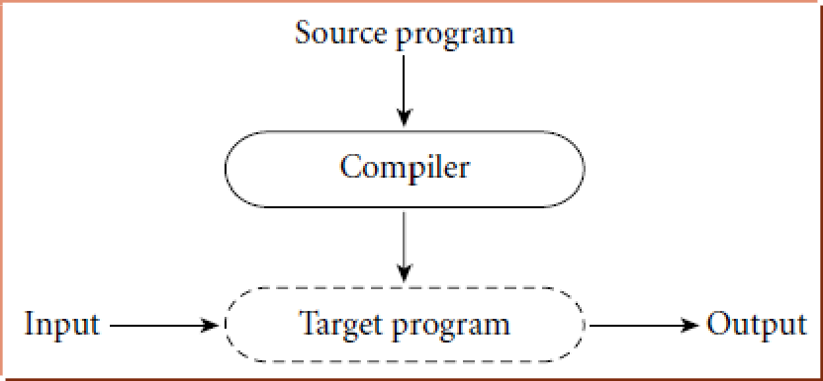
Compilation vs. Interpretation
Compilation vs. interpretation
not opposites
not a clear-cut distinction
Pure Compilation:
The compiler translates the high-level source program into an equivalent target program (typically in machine language), and then goes away:

Slide 17

Compilation vs. Interpretation
Pure Interpretation:
The interpreter stays around for the execution of the program
The interpreter is the locus of control during execution

Slide 18
Compilation vs. Interpretation
Compilation
Better performance!
Interpretation:
Greater flexibility: real-time development
Better diagnostics (error messages)

Slide 19
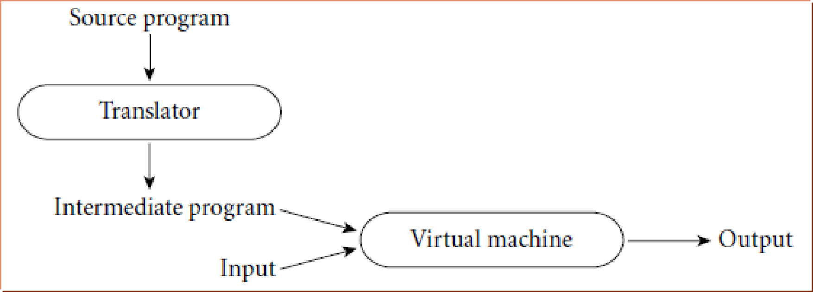
Compilation vs. Interpretation
Most modern language implementations include a mixture of both compilation and interpretation
Compilation followed by interpretation:

Slide 20
Implementation strategies
The Preprocessor:
Removes comments and white space
Expands abbreviations in the style of a macro assembler
Conditional compilation: if-else directives #if, #ifdef, #ifndef, #else, #elif and #endif – example:
#ifdef unix
# include <unistd.h> #elif defined _WIN32 # include <windows.h> #endif
Groups characters into tokens (keywords, identifiers,
numbers, symbols)
Identifies higher-level syntactic structures (loops, subroutines)

Slide 21
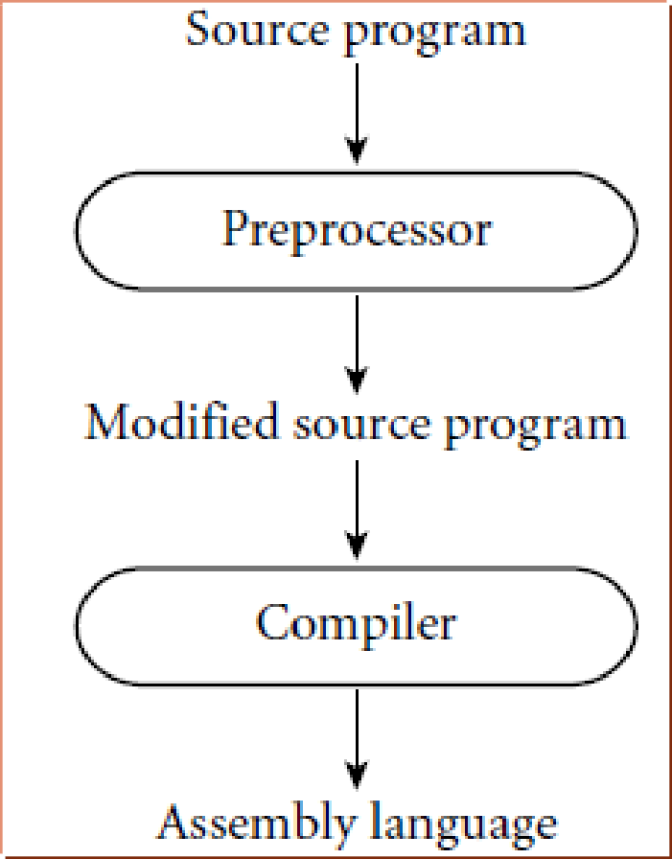
Preprocessor
The C Preprocessor:
removes comments
expands macros
conditional compilation

Slide 22
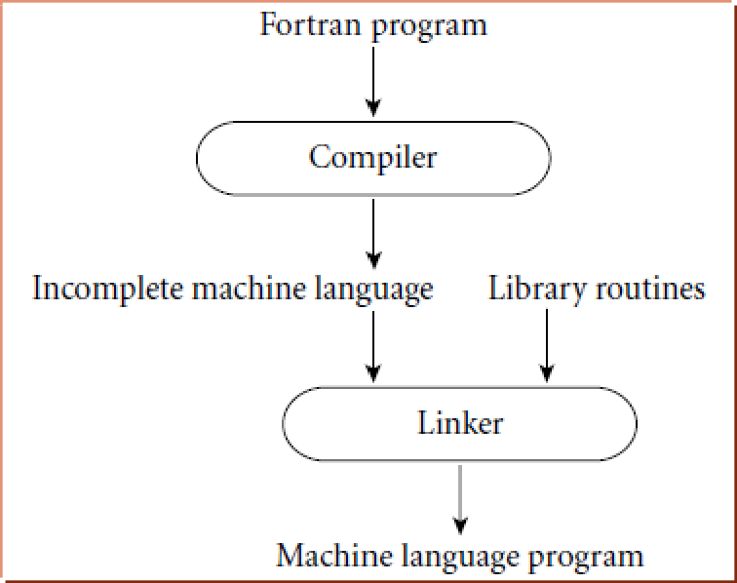
Implementation strategies
Library of Routines and Linking
The compiler uses a linker program to merge the appropriate library of subroutines (e.g., math functions such as sin, cos, log, etc.) into the final program:

Slide 23
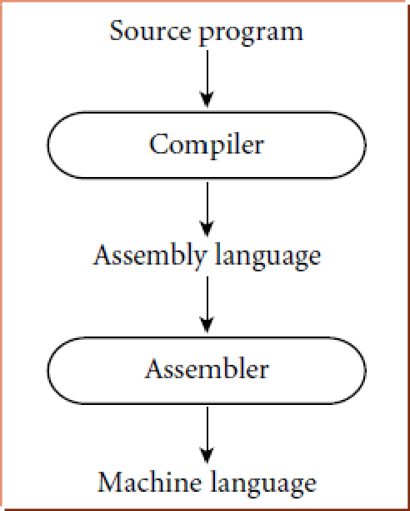
Implementation Strategies
Post-compilation Assembly: the compiler's output is assembly instead of machine code
Facilitates debugging (assembly language easier for people to read)
Isolates the compiler from changes in the format of machine language files (only assembler must be changed, is shared by many compilers)

Slide 24
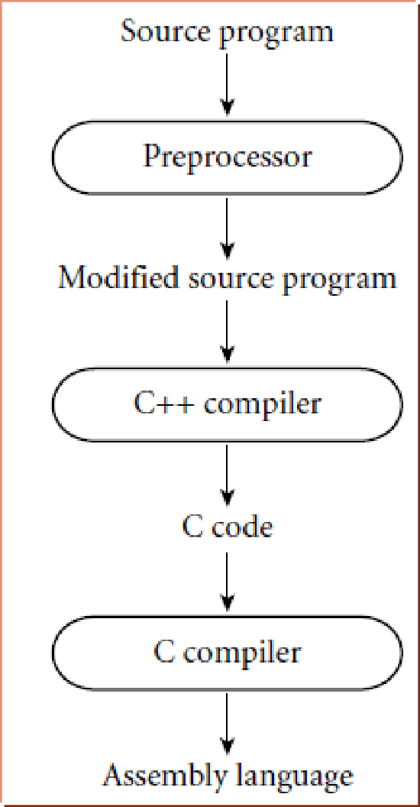
Implementation Strategies
Source-to-Source Translation
C++ implementations based on the early AT&T compiler generated an intermediate program in C, instead of an assembly language

Slide 25
Implementation Strategies
Bootstrapping: many compilers are self-hosting: they are written in the language they compile
How does one compile the compiler in the first place?
One starts with a minimal subset of the language implementation—often an interpreter (which could
be written in assembly language) to compile a core language (parsing, semantic analysis and execution).
Then successively use this small implementation to compile expanded versions of the compiler.

Slide 26
Implementation Strategies
Minimal version of the compiler written in assembly language or C
Main Code written in different language like Python
Minimal version of the compiler written in assembly language or C
Main Code written in different language like Python
Minimal version of the compiler written in assembly language or C
Takes few portion of code
Compiles itself
Becomes stronger

Slide 27
Implementation Strategies
Bootstrapping is related to self-hosting:
Ken Thompson started development on Unix in 1968 by writing the initial Unix kernel, a command interpreter, an editor, an assembler, and a few utilities on GE-635.
Then the Unix operating system became self-hosting: programs could be written and tested on Unix itself.
Development of the Linux kernel was initially hosted on a Minix system.

Slide 28
Bootstrapping Advantage and Disatvantage
Bootstrapping ensures that the compiler is compatible with the language it is designed to compile, as it is written in the same language.
It allows for greater control over the optimization and code generation process.
It provides a high level of confidence in the correctness of the compiler because it is self-hosted.
It can be a time-consuming process, especially for complex languages or compilers.
Debugging a bootstrapped compiler can be challenging since any errors or bugs in the compiler will affect the subsequent versions of the compiler.
Bootstrapping requires that a minimal version of the compiler be written in a different language, which can introduce compatibility issues between the two languages.

Slide 29
Some Important Programming languages
1. Fortran (1957): The First High-Level Language
Developed by IBM, Fortran (short for "Formula Translation") was designed for scientific and engineering calculations.
It introduced the concept of a compiler, which translated high-level code into machine code.
Fortran made programming more accessible and efficient for scientists and engineers.
2. COBOL (1959): Business-Oriented Programming
COBOL (Common Business-Oriented Language) was developed for business data processing.
It focused on readability and was designed to be easily understood by non-programmers.
COBOL played a significant role in the automation of business operations.

Slide 30
Some Important Programming languages
3. LISP (1958): Symbolic Computing
LISP (LISt Processing) was developed for artificial intelligence research.
It introduced symbolic expressions, allowing programs to manipulate data and code as lists.
LISP's influence can be seen in modern programming paradigms like functional programming.
4. ALGOL (1958): The Birth of Structured Programming
ALGOL (ALGOrithmic Language) aimed to define a universal standard for programming languages.
It introduced block structures, nested scopes, and other concepts that formed the basis of structured programming.
ALGOL's influence can be seen in languages like Pascal and C.

Slide 31
Some Important Programming languages
5. C (1972): A Foundation for Modern Programming
Developed by Dennis Ritchie at Bell Labs, C became a powerful and versatile language.
It was instrumental in the development of the Unix operating system.
C's influence can be seen in many modern programming languages, and it's still widely used today.
6. Smalltalk (1972): Object-Oriented Programming Emerges
Smalltalk introduced the concept of object-oriented programming (OOP).
It emphasized the use of objects, encapsulation, and inheritance for more modular and maintainable code.
OOP became a fundamental paradigm in languages like Java, C++, and Python.

Slide 32
Some Important Programming languages
7. PASCAL (1970): Symbolic Computing
PASCAL was developed by Niklaus Wirth
It was created to build upon ALGOL
Pascal was created in order to make learning programming easier, and make it easier to teach programming in a structured fashion which emphasizes improving the clarity and quality of a programming language
It was also created to be efficient in creating large programs
Overtime it became a very popular language to teach due to its design of being easy to learn, efficient and reliable.
8. ADA (1980): The Birth of Structured Programming
Originally designed for embedded and real time systems
Wide range of target processors are supported
Rich and mature development environments and toolsets
Used for large software systems
Ease of learning
Smooth integration into existing projects and ease of interoperating with C and C++

Slide 33
Some Important Programming languages
9. C++ (1983): Object-Oriented Evolution
C++ extended C with object-oriented features.
It introduced classes, templates, and other enhancements, making it a versatile language for both system and application programming.
10. Python (1991): Readability and Versatility
Python was designed for readability and ease of use.
Its clean syntax and dynamic typing made it popular for scripting, web development, data analysis, and more.
Python's popularity continues to grow rapidly.

